Slide 1
Web Applications in Eclipse

Slide 2
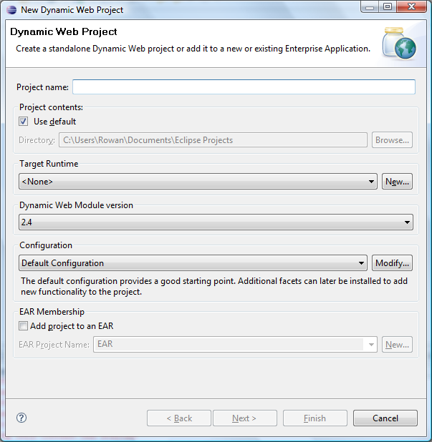
Dynamic Web Project Wizard
This wizard will create a web app in Eclipse, which can be automatically deployed to a server

Slide 3
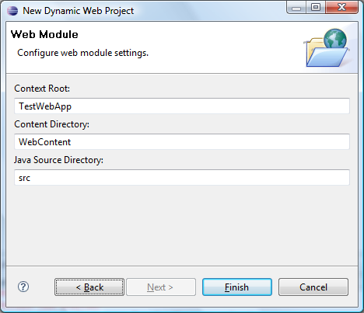
Dynamic Web Project Wizard
The context root is the base url for the web app on the server, e.g.
localhost:8080/TestWebApp

Slide 4
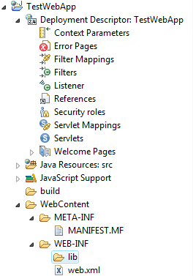
Dynamic Web Project Wizard
The wizard automatically creates a suitable folder structure and a deployment descriptor

Slide 5
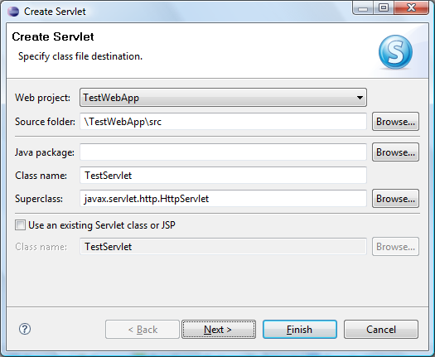
Servlet Wizard: Page 1
Here we can specify the name and package of the servlet class

Slide 6
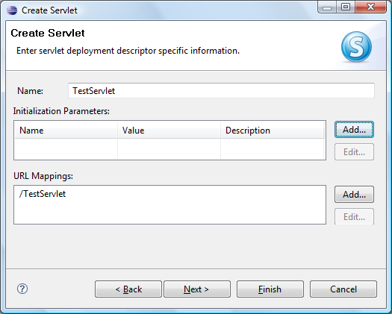
Servlet Wizard: Page 2
Here we can specify the URL mapping for the servlet

Slide 7
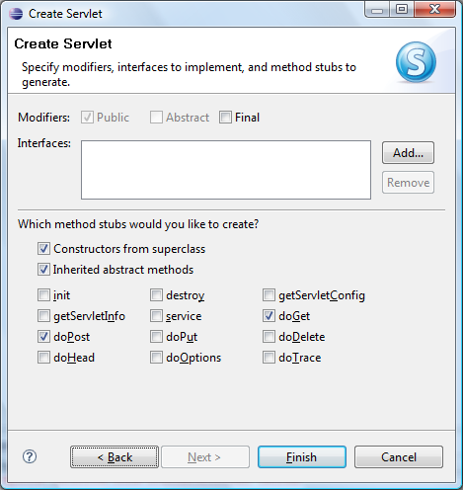
Servlet Wizard: Page 3
Here we can add stubs for the commonly used servlet methods, namely:
doGet
doPost
init
destroy
service

Slide 8
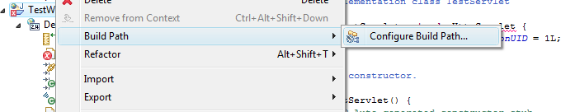
The Servlet API
The Java Servlet API uses the javax.servlet.* namespace
It is not part of the standard Java JDK, so has to be added as an external JAR
It is added to the build path as follows...

Slide 9
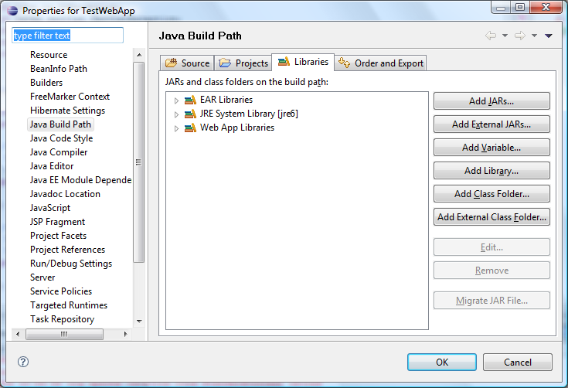
The Servlet API
The servlet API JAR is vendor specific,
i.e. a J2EE server such as Tomcat provides its own servlet API JAR
Browse for
<tomcat home>/lib/servlet-api.jar

Slide 10
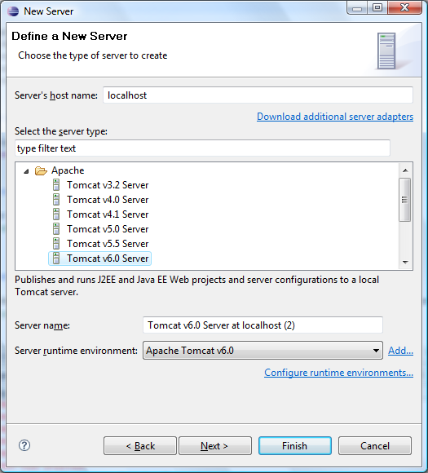
Running a Web App
Eclipse can automatically deploy a web app to a J2EE server
Choose "Run on Server" and Eclipse will display the New Server wizard
Here you can add your Tomcat installation as a server configuration

Slide 11
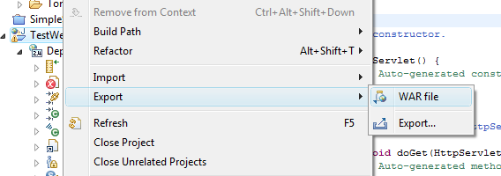
WAR Files
Eclipse can easily generate a WAR file from a web project...

